Slide 1


Slide 2
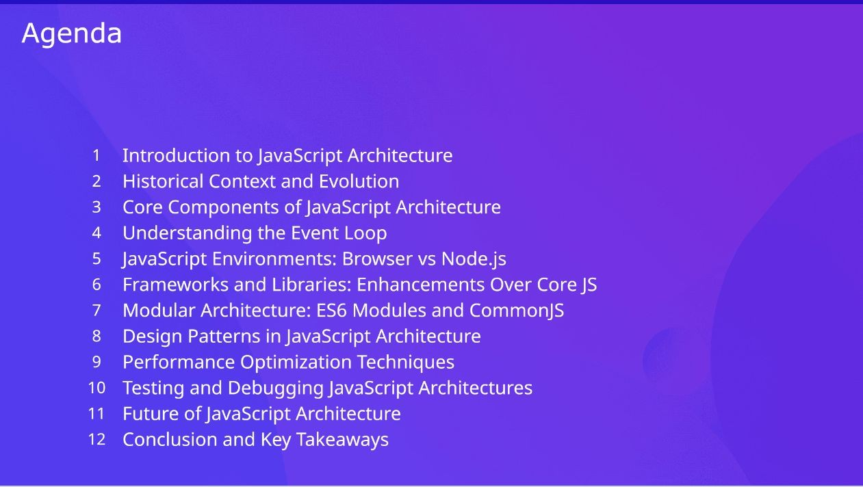

Slide 3

JavaScript architecture refers to the structured organization of code and the interaction between various components to deliver functionality. It focuses on modularity, enabling reusable components, event-driven design for efficient asynchronous handling, and ensuring maintainability for easy updates and scaling. Performance optimization and clear separation of concerns—keeping logic, presentation, and data handling distinct—are also key aspects. A well-designed JavaScript architecture ensures efficiency, adaptability, and scalability for future growth and development.

Slide 4


Slide 7
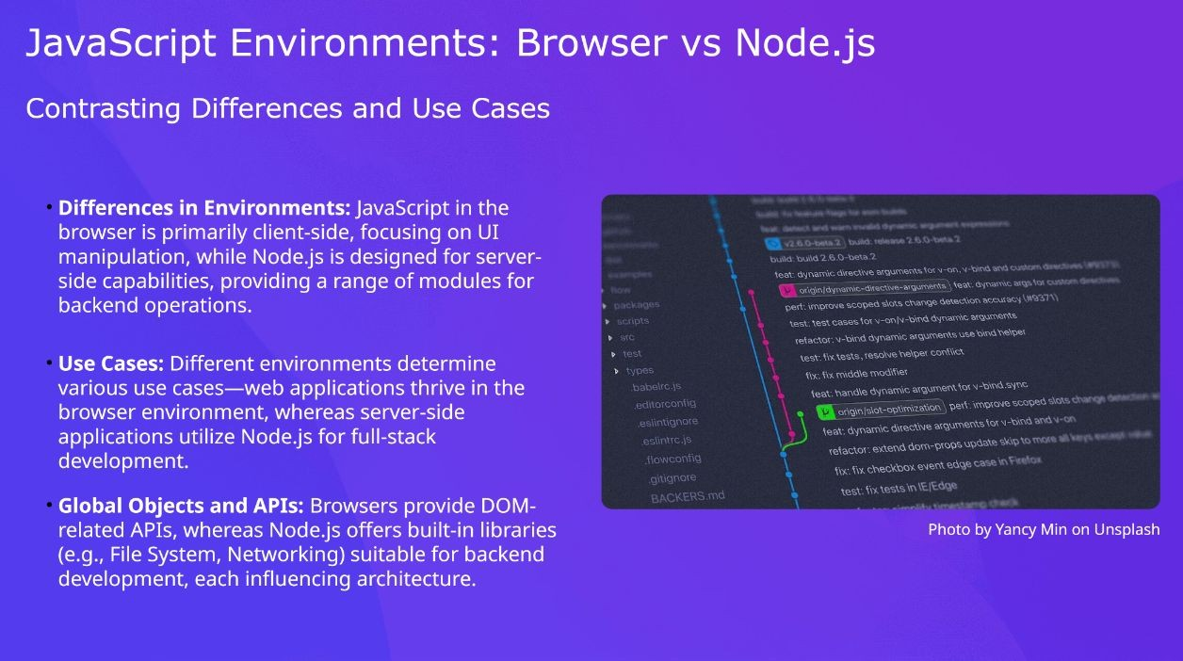

Slide 8
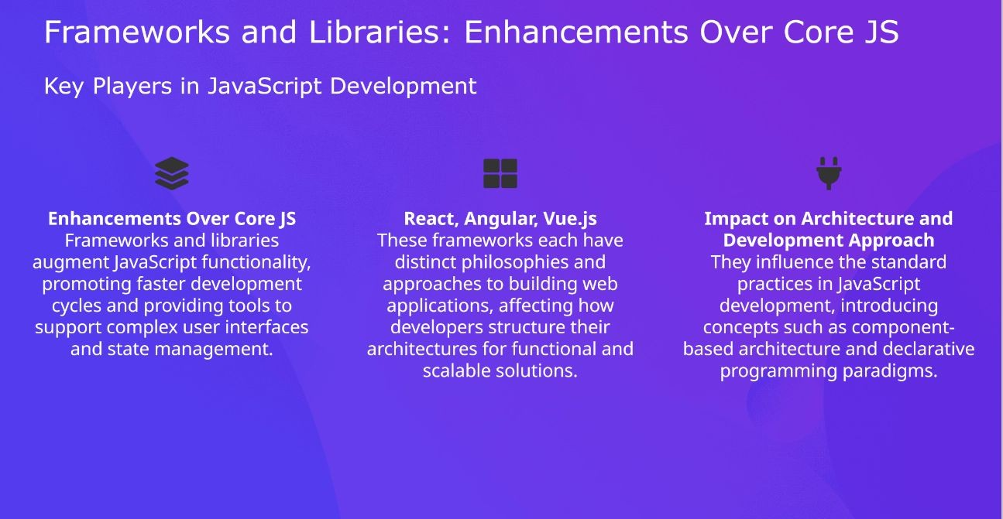

Slide 9
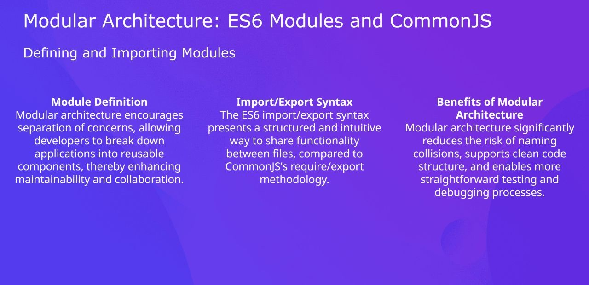

Slide 10
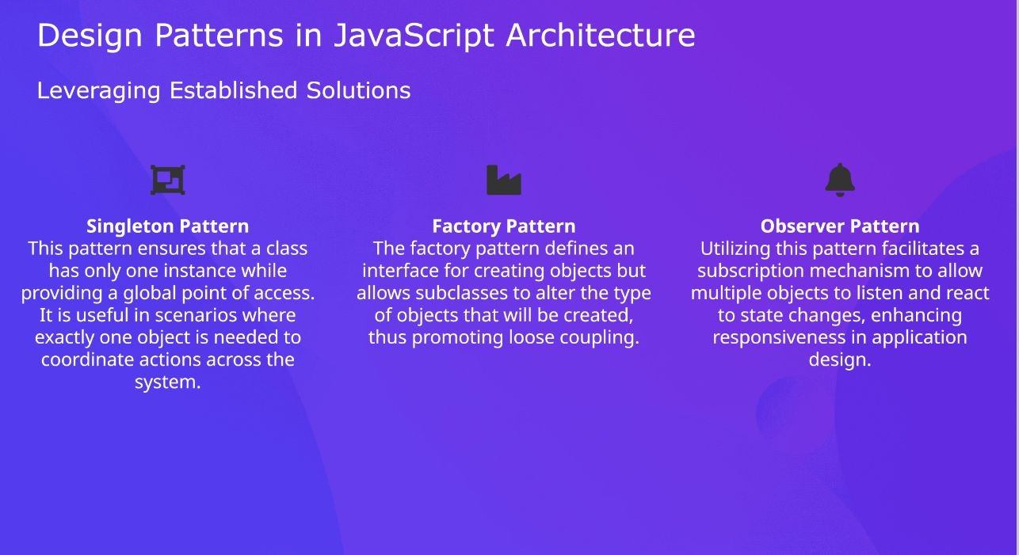

Slide 11


Slide 12
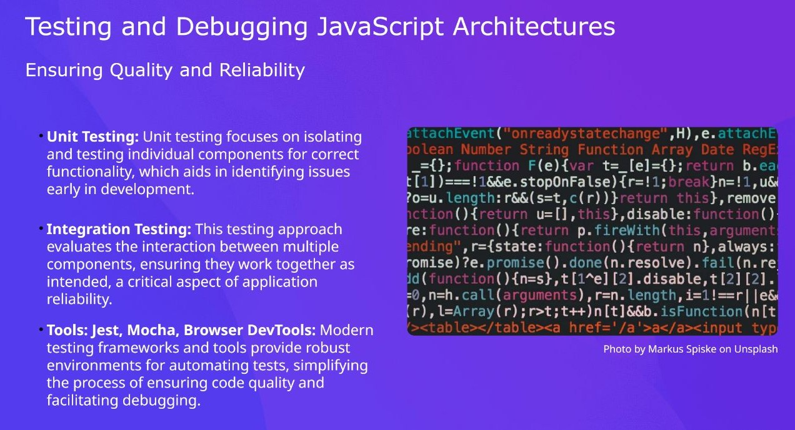

Slide 13


Slide 14


